Slide 1
prisma
Create tables

Slide 2
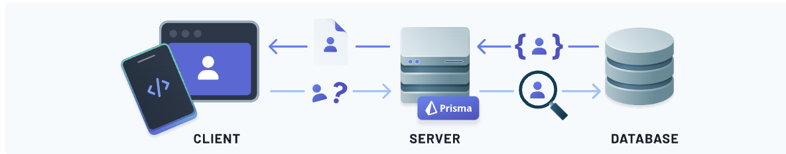
Prisma create a model

Slide 3
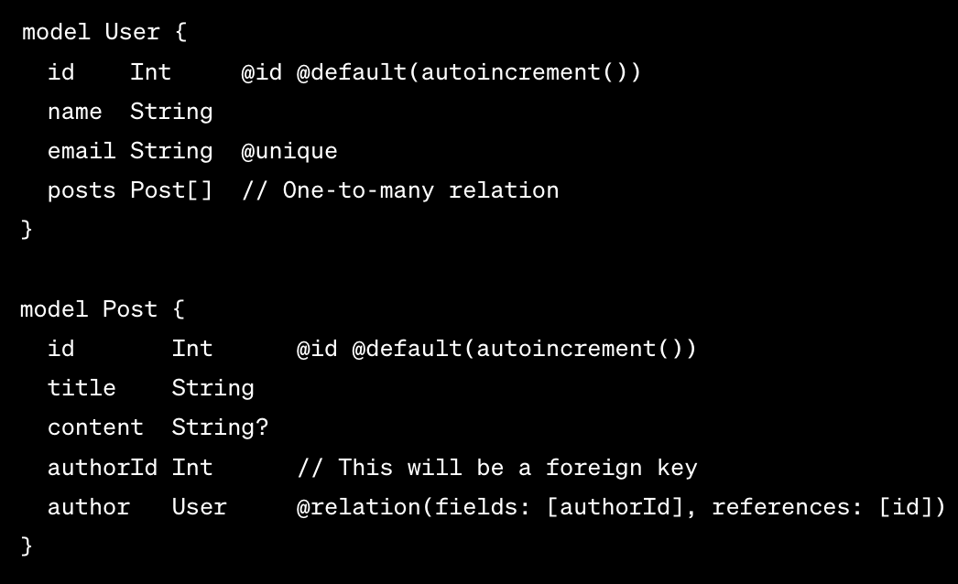
One to many
One user can have many posts

Slide 4
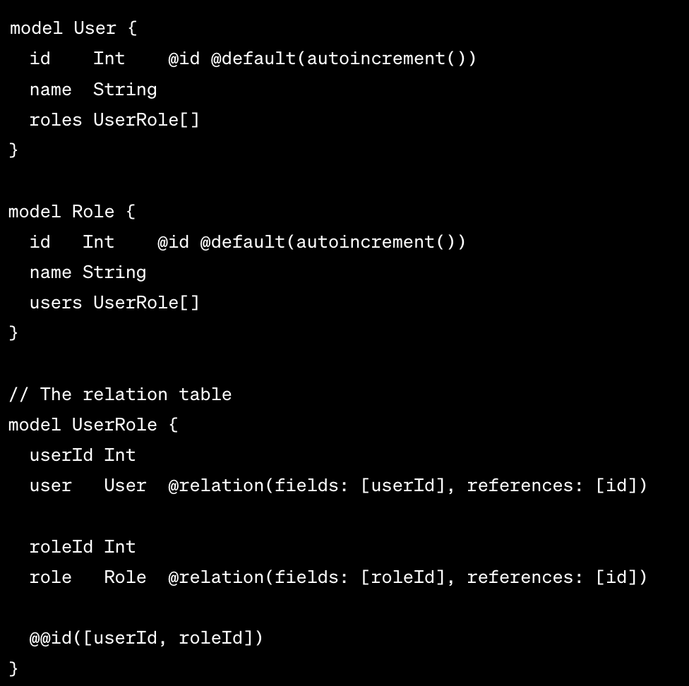
Many to many

